Slide 1
Supply Chain Management
Lecturer: Ngo Huy Bien
Software Engineering Department
Faculty of Information Technology
VNUHCM - University of Science
Ho Chi Minh City, Vietnam
nhbien@fit.hcmus.edu.vn

Slide 2

Objectives

Slide 3

Contents

Slide 4

References
Ellen Monk and Bret Wagner (2012).Concepts in Enterprise Resource Planning. Cengage Learning.
Sunil Chopra (2018). Supply Chain Management. Pearson.

Slide 5
Functional Areas [1]
Companies that make and sell products have business processes that involve four main functional areas:
Marketing and Sales (M/S),
Supply Chain Management (SCM),
Accounting and Finance (A/F), and
Human Resources (HR).
Each functional area is served by an information system.
Information systems capture, process, and store data to provide information needed for decision making.

Slide 6
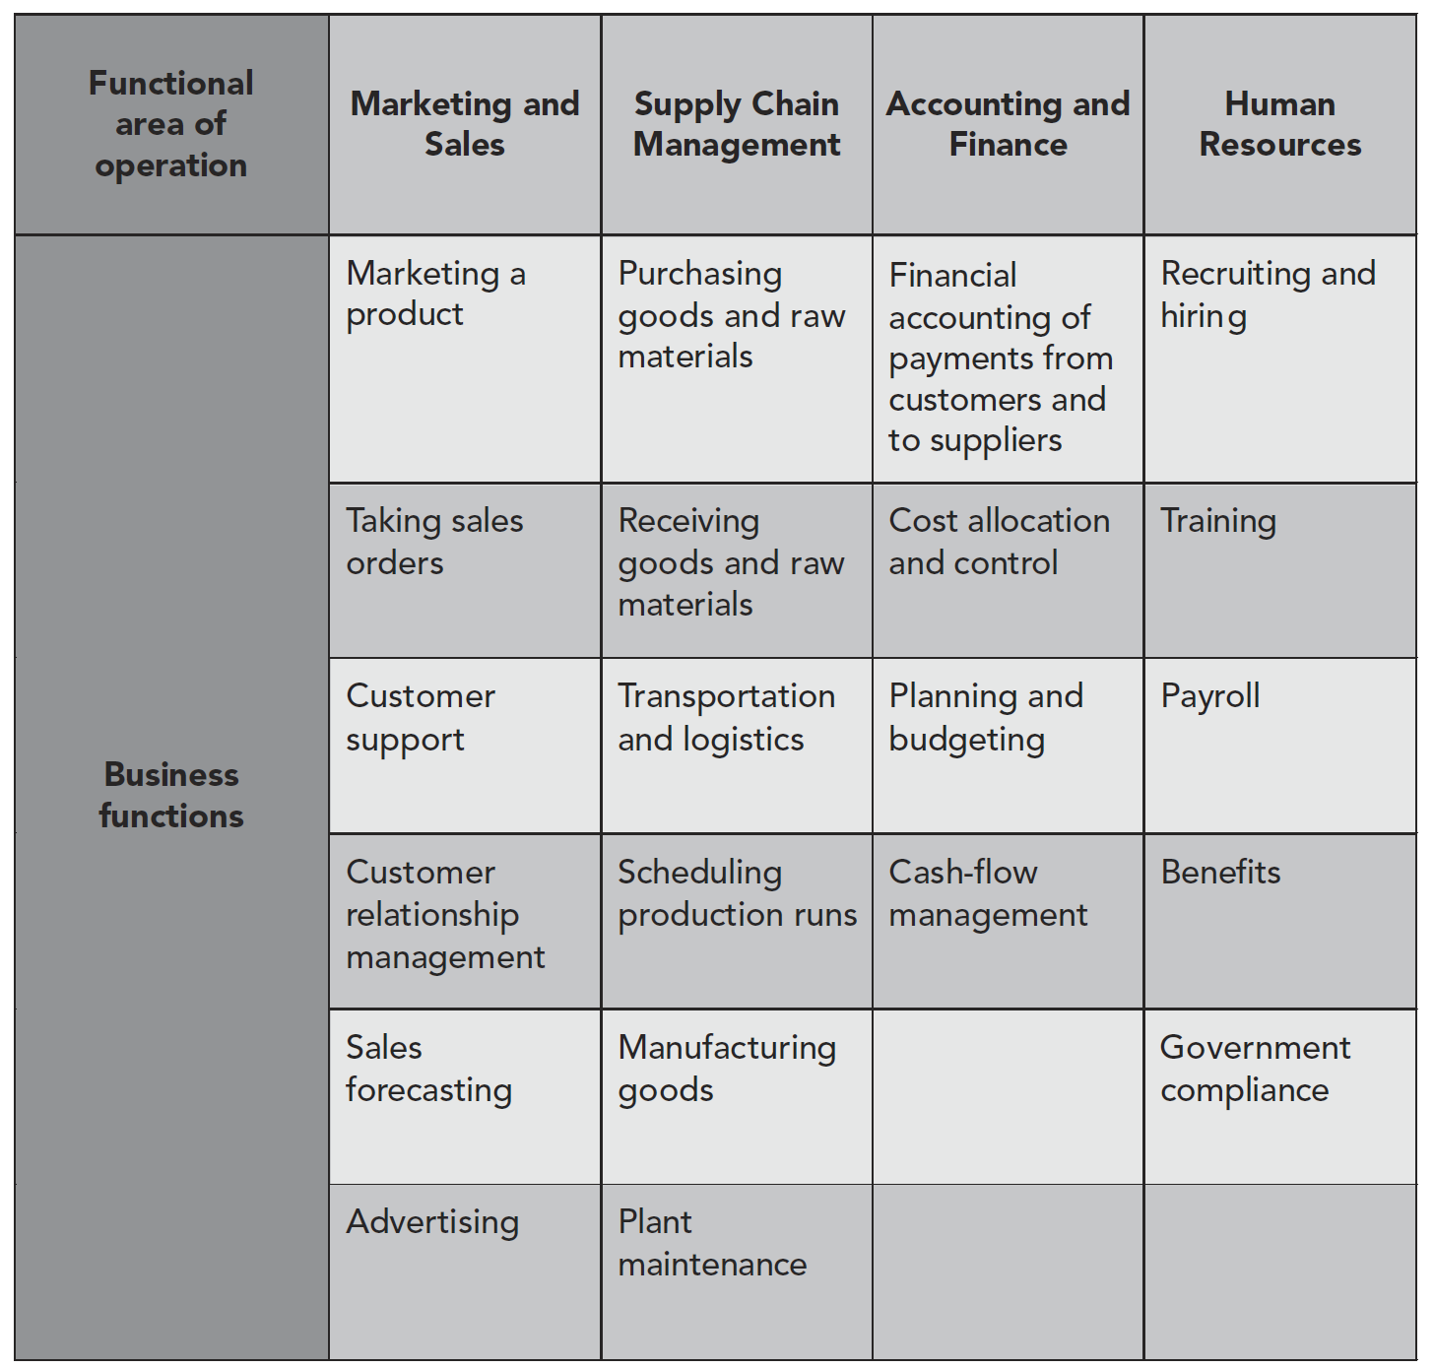
Functional Areas of Operation

Slide 7
ERP Systems
Enterprise Resource Planning (ERP) systems are core software programs used by companies to integrate and coordinate information in every area of the business.
A business process is a collection of activities that takes one or more kinds of input and creates an output, such as a report or forecast, that is of value to the customer.
ERP software supports the efficient operation of business processes by integrating tasks related to sales, marketing, manufacturing, logistics, accounting, and staffing—throughout a business.

Slide 8
Why ERP Systems?
An Enterprise Resource Planning (ERP) system can help a company integrate its operations by serving as a company-wide computing environment that includes a shared database—delivering consistent data across all business functions in real time.
(The term real time refers to data and processes that are always current).
Increasing the efficiency of information systems results in more efficient management of business processes.
When companies have efficient business processes, they can be more competitive in the marketplace.

Slide 9
MRP Software
Material requirements planning is a production-scheduling methodology that determines the timing and quantity of production runs and purchase-order releases to meet a master production schedule.
The plant manager first looked at Marketing and Sales’ forecast of customer demand, then looked at the production schedule needed to meet that demand, calculated the raw materials needed to meet the required production levels, and finally, projected the cost of those raw materials.
For a company with many products, raw materials, and shared production resources, this kind of projection was impossible without a computer to keep track of various inputs.
MRP software allowed a plant manager to plan production and raw materials requirements by working backward from the sales forecast, the prediction of future sales.

Slide 10
Electronic Data Interchange
The basic functions of MRP could be handled by mainframe computers; however, the advent of electronic data interchange (EDI)—the direct computer-to-computer exchange of standard business documents—allowed companies to handle the purchasing process electronically, avoiding the cost and delays resulting from paper purchase order and invoice systems.
The functional area now known as Supply Chain Management (SCM) began with the sharing of long-range production schedules between manufacturers and their suppliers.

Slide 11
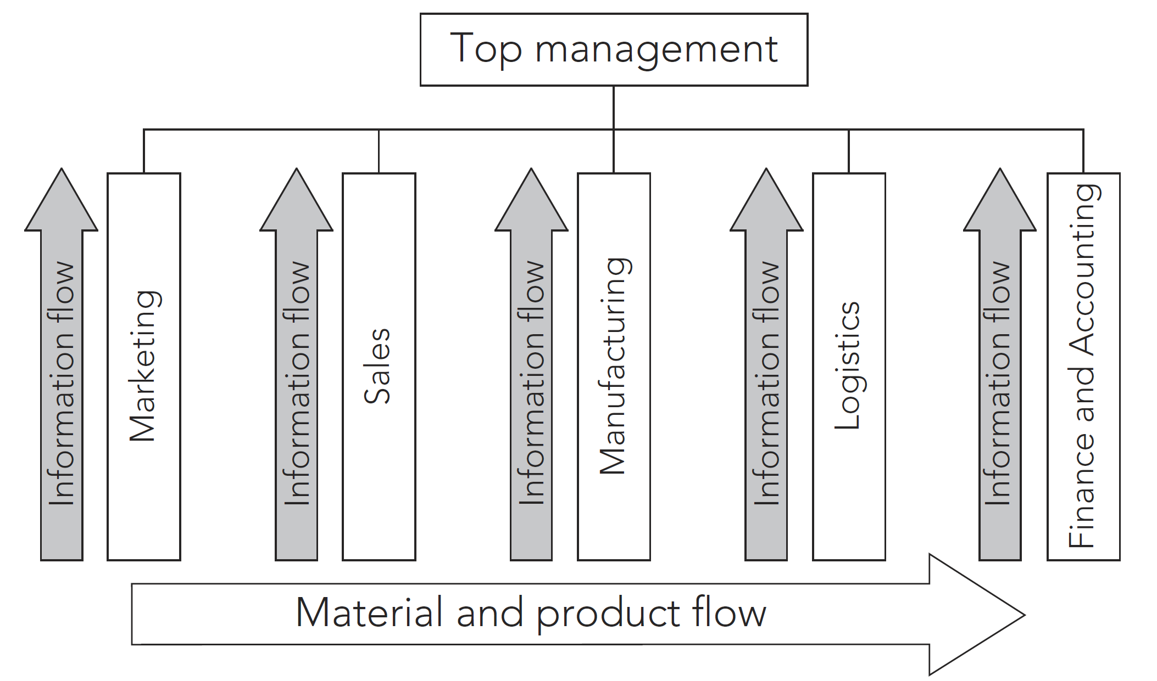
Information and Material Flows in a Functional Business Model

Slide 12
The Functional Model
The functional model was very useful for decades, and it was successful in the United States where there was limited competition and where flexibility and rapid decision making were not requirements for success.
In the quickly changing markets of the 1990s, however, the functional model led to top-heavy and overstaffed organizations incapable of reacting quickly to change.

Slide 13
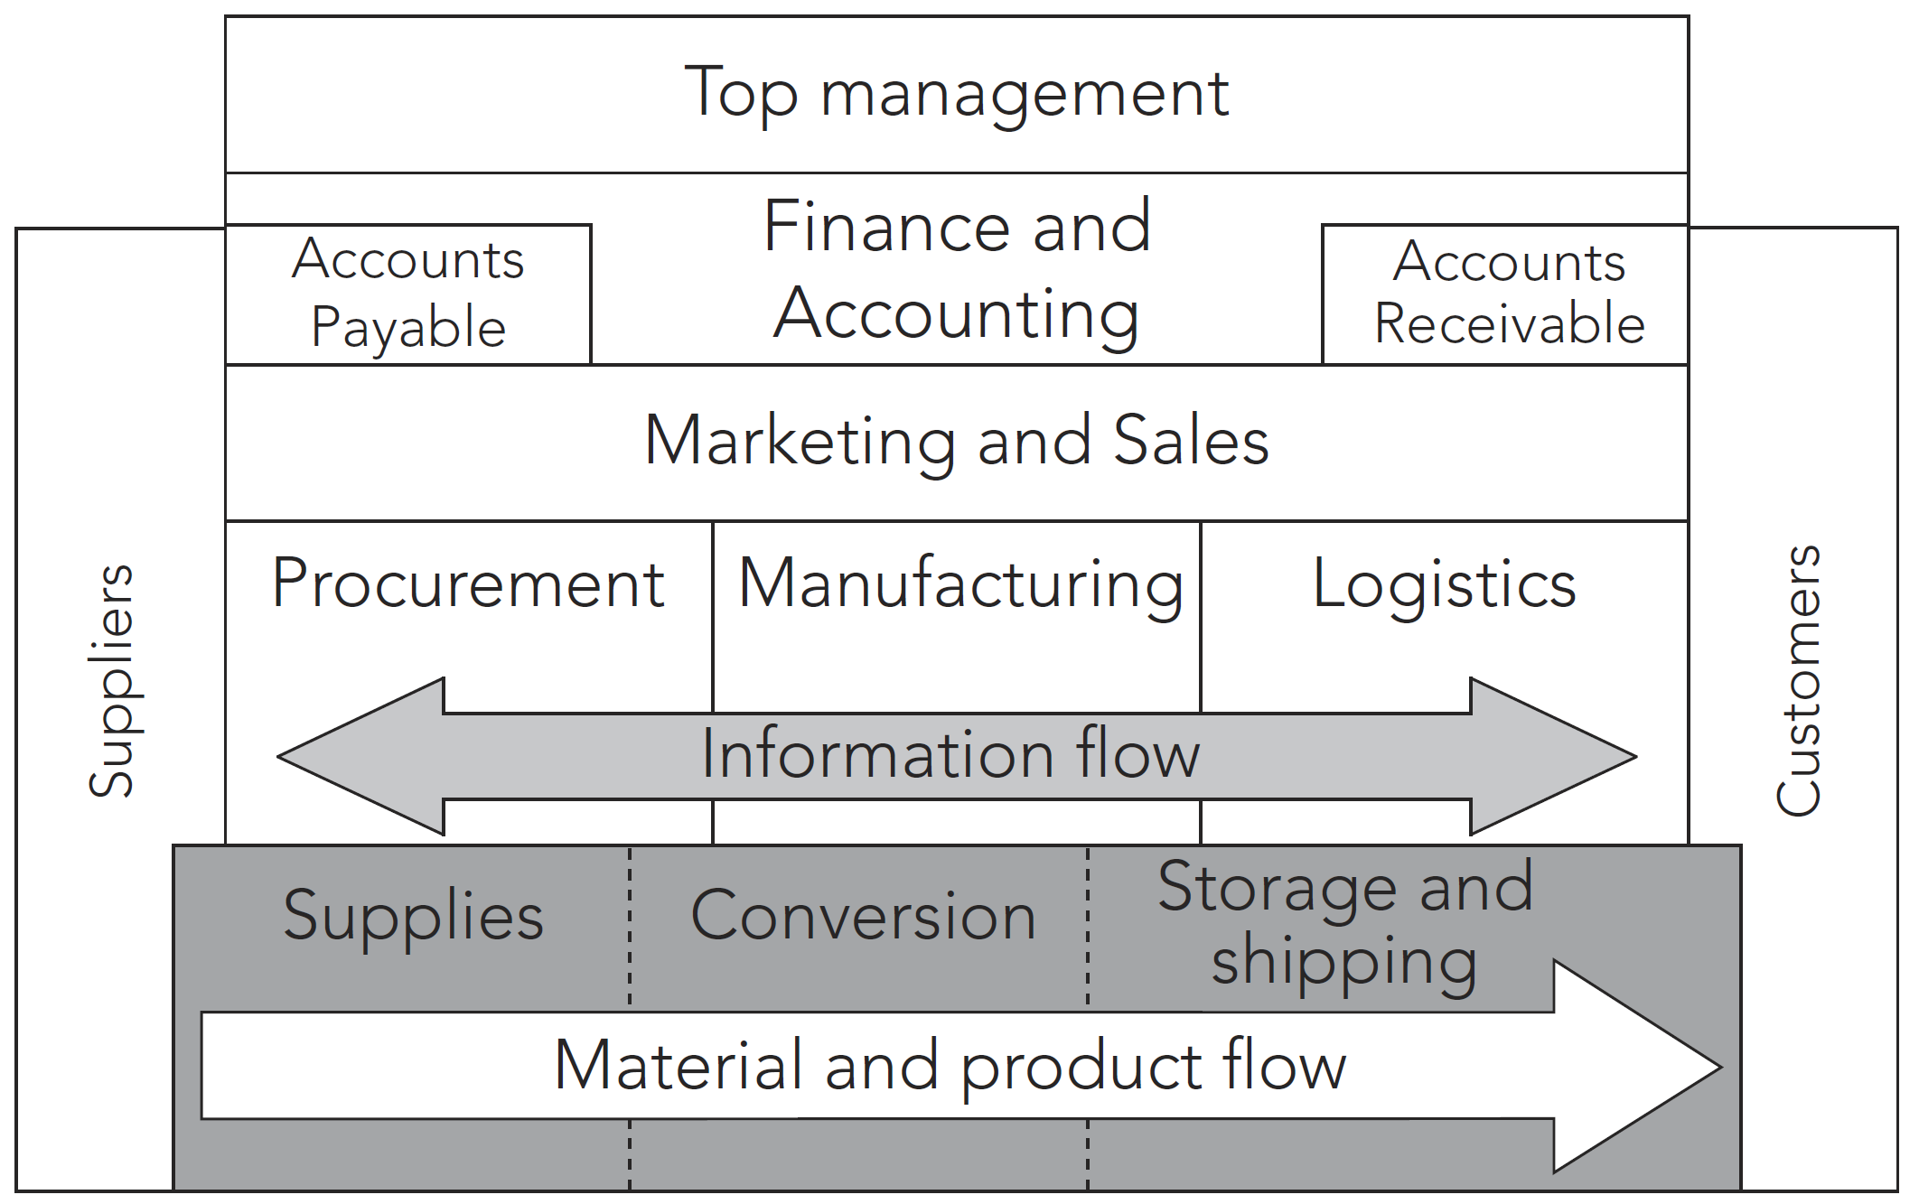
Information and Material Flows in a Process Business Model

Slide 14
The Process-Oriented Model
In a process-oriented company, the flow of information and management activity is “horizontal” across functions, in line with the flow of materials and products.
Now information flows between the operating groups without top management’s involvement.
This horizontal flow promotes flexibility and rapid decision making.

Slide 15
Systems Analysis and Program Development (1972)
Later, the acronym was changed to Systems, Applications and Products in Data Processing.
All companies developing computer software faced the same basic business problems, and each developed unique, but similar, solutions for their needs in payroll processing, accounting, materials management, and other functional areas of business.
SAP’s goal was to develop a standard software product that could be configured to meet the needs of each company.

Slide 16
SAP R/3 (1988)
The SAP R/3 system was also designed using an open architecture approach.
In open architecture, third-party software companies are encouraged to develop add-on software products that can be integrated with existing software.
The open architecture also makes it easy for companies to integrate their hardware products, such as bar-code scanners, personal digital assistants (PDAs), cell phones, and global information systems with the SAP system.

Slide 17
Oracle (1979)
In 1979, Oracle released its first commercial database product.
The company continued to improve its database product, and in 1988 released Oracle Financials, a set of financial applications.
The financial applications suite of modules included Oracle Financials, Oracle Supply Chain Management, Oracle Manufacturing, Oracle Project Systems, Oracle Human Resources, and Oracle Market Management. Oracle Financials was the foundation for what would become Oracle’s ERP product.
Oracle is now SAP’s biggest competitor.

Slide 18
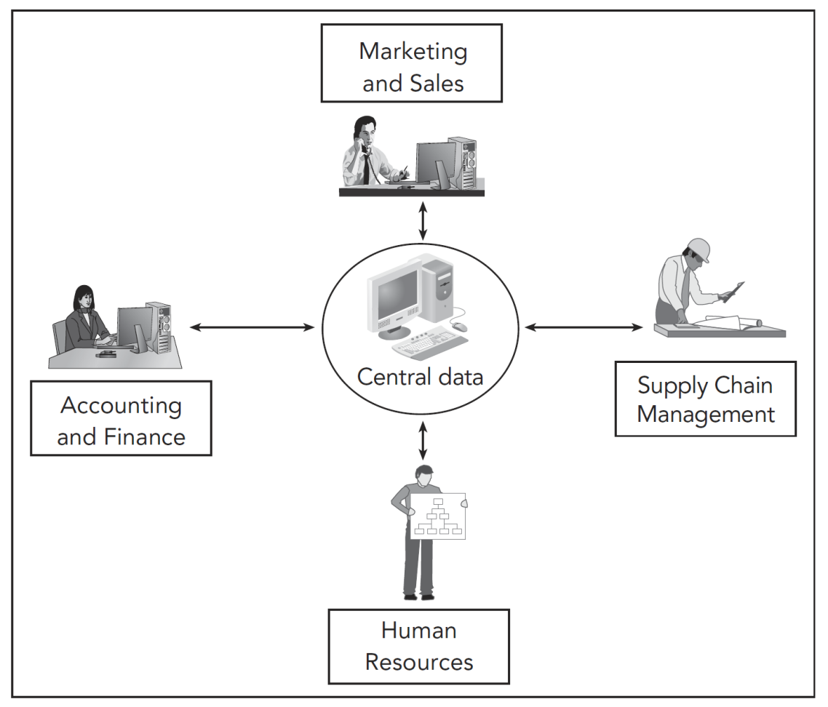
SAP ERP Software

Slide 19
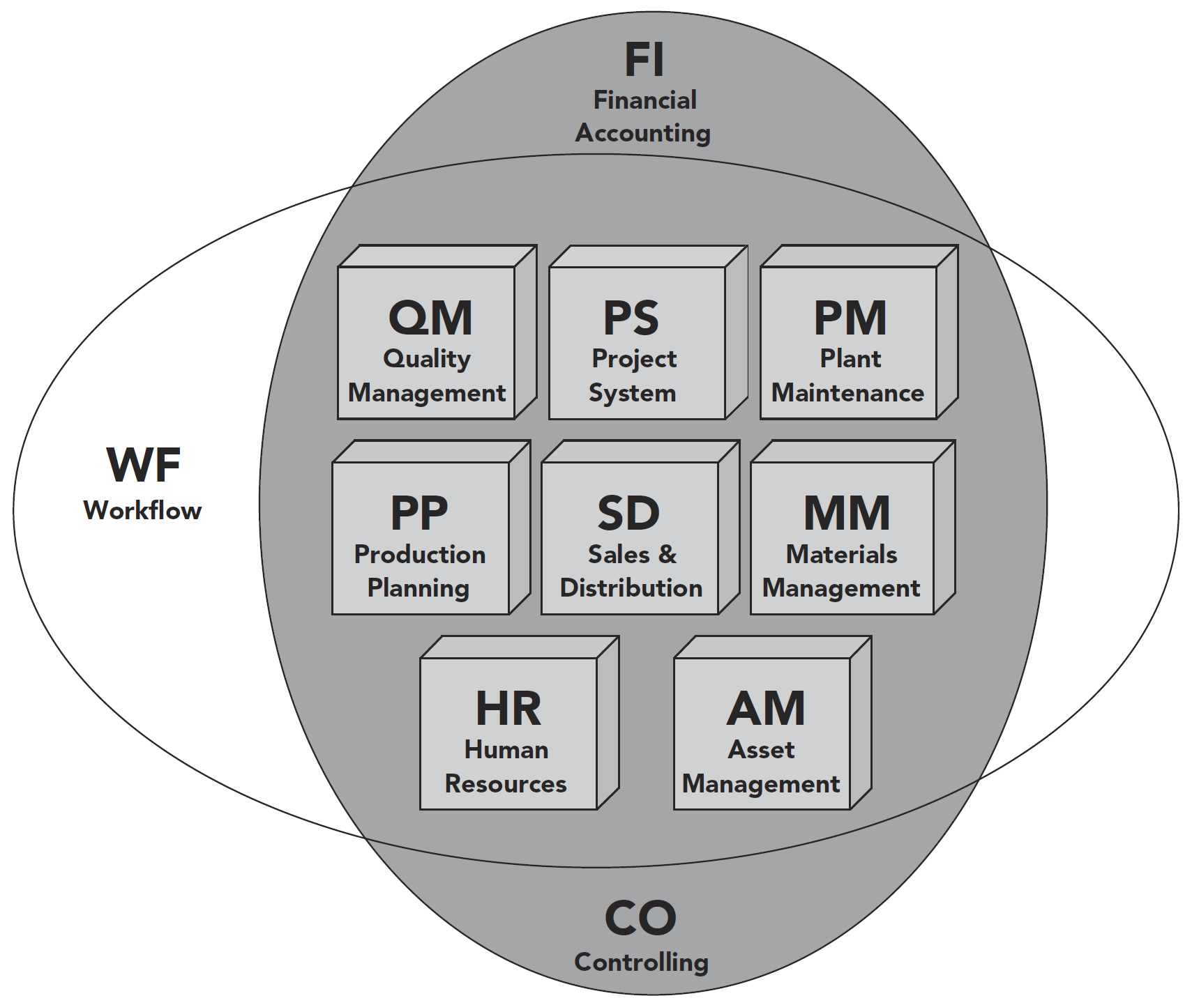
Modules within the SAP ERP

Slide 20
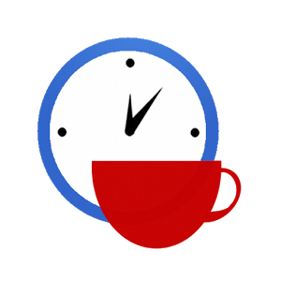

Slide 21
Supply Chain [2]
A supply chain consists of all parties involved, directly or indirectly, in fulfilling a customer request.
The supply chain includes not only the manufacturer and suppliers, but also transporters, warehouses, retailers, and even customers themselves.
Within each organization, such as a manufacturer, the supply chain includes all functions involved in receiving and filling a customer request.
These functions include, but are not limited to, new product development, marketing, operations, distribution, finance, and customer service.

Slide 22
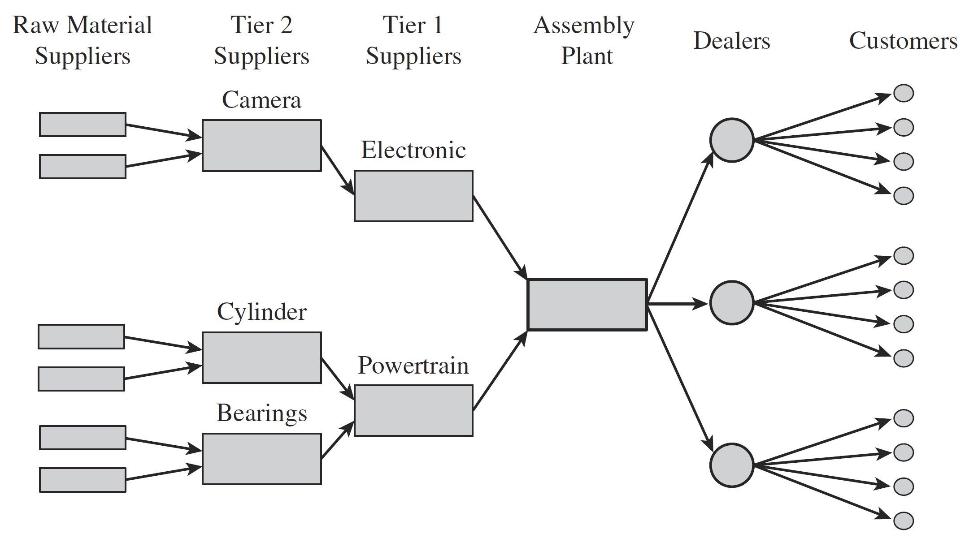
Stages of an Automotive Supply Chain

Slide 23
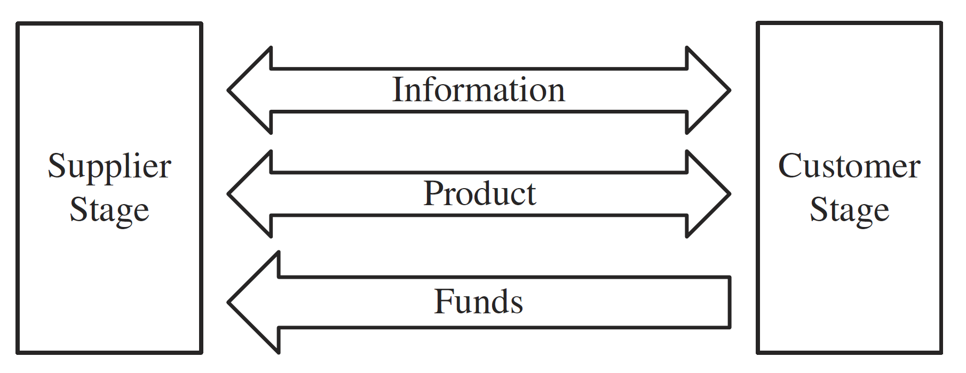
The Three Flows in a Supply Chain

Slide 24
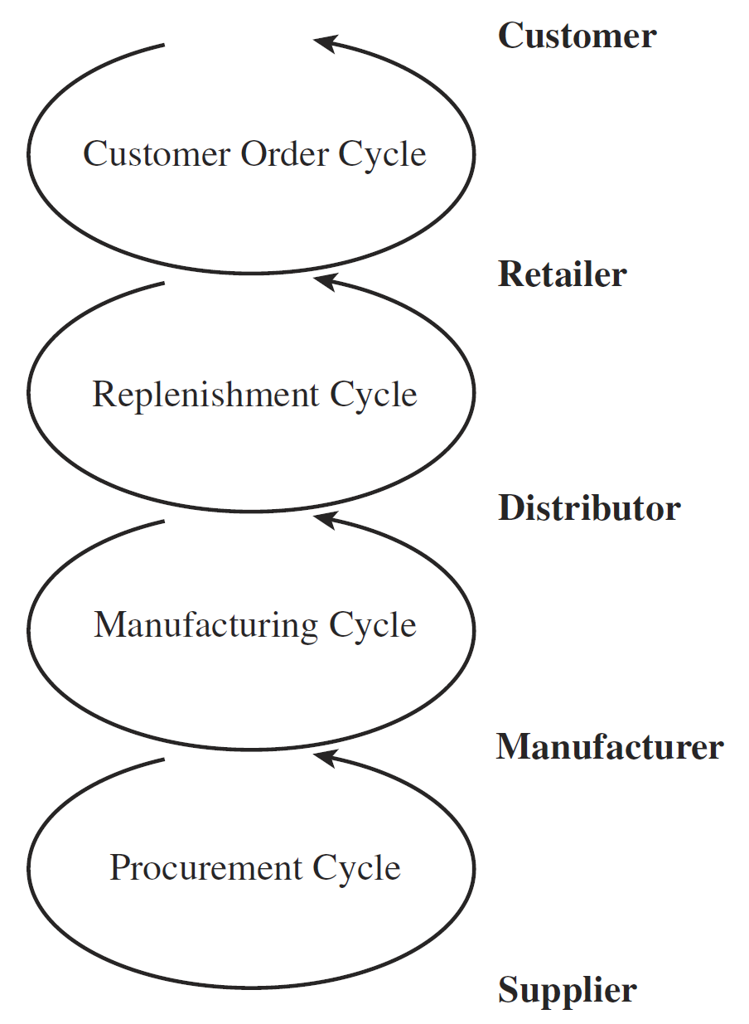
Supply Chain Process Cycles

Slide 25
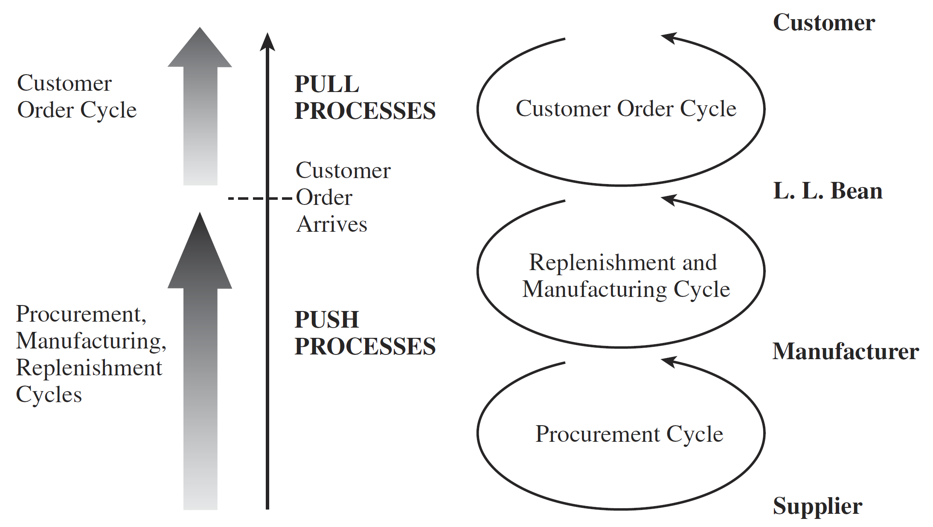
Push/Pull Processes for the L. L. Bean Supply Chain

Slide 26
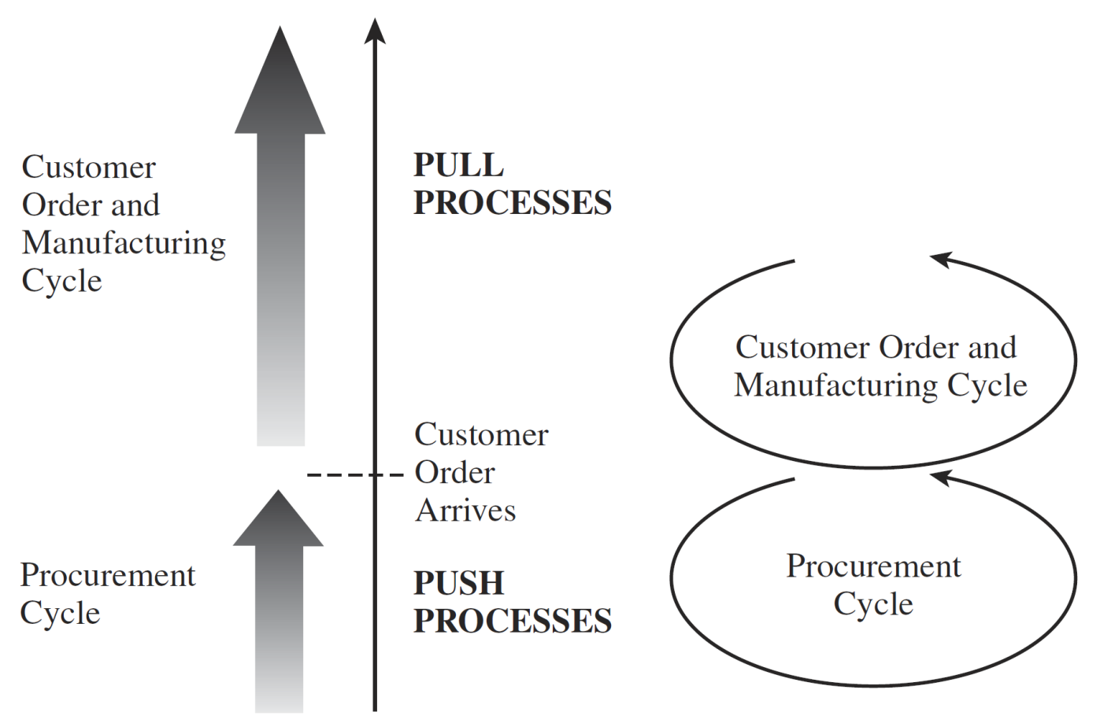
Push/Pull Processes for Ethan Allen Supply Chain for Customized Furniture

Slide 27
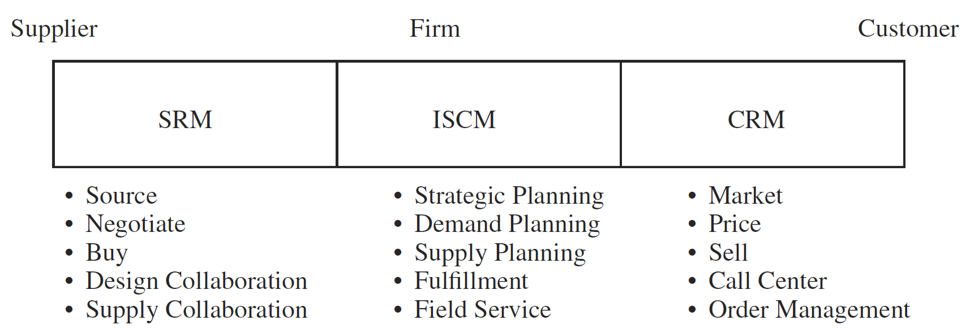
Supply Chain Macro Processes in a Firm
Customer relationship management (CRM): all processes at the interface between the firm and its customers.
Internal supply chain management (ISCM): all processes that are internal to the firm.
Supplier relationship management (SRM): all processes at the interface between the firm and its suppliers.

Slide 28
Inventory Terms
A lot or batch size is the quantity that a stage of a supply chain either produces or purchases at a time.
Consider, for example, a computer store that sells an average of four printers a day. The store manager, however, orders 80 printers from the manufacturer each time he places an order. The lot or batch size in this case is 80 printers.
Safety inventory is inventory carried to satisfy demand that exceeds the amount forecast. Safety inventory is required because demand and supply are uncertain, and a product shortage may result if actual demand exceeds the forecast demand or supply is later than anticipated.

Slide 30
SCM vs. ERP
Supply Chain Management is a management discipline (broader scope).
SCM exists independently of any specific software.
Enterprise Resource Planning is an integrated enterprise system (implementation tool).
ERP is therefore a technology platform, not a management discipline.
SCM is a business discipline, and ERP is a software system that supports and integrates SCM processes.

Slide 31
Management Perspective
Business Management
└── Supply Chain Management (SCM) ← management discipline
└── Supported by ERP systems ← software/tool

Slide 32
Systems Perspective
ERP system
├── Finance module
├── HR module
├── Manufacturing module
└── SCM-related modules
├── Inventory
├── Procurement
└── Logistics

Slide 33

Thank You & See You Again

